Slide 1
SURA REPORT I
Facilitator – Prof. Devendra Kr Dubey
Tanmay Goyal
Kshitij Gupta

Slide 2
Objectives Proposed after Incorporating Suggestions in Presentation
1. To create an integrated regular health monitoring and medical report generating machine. 2. Provisionally planning to integrate/ make machines monitoring - a. Blood Sugar level b. Blood pressure c. Body Weight d. Body Temperature e. Lung capacity 3. To understand the working of relevant medical equipment and to implement them directly or in a modified way in our design. 4. To enhance the convenience of regular health monitoring by-
Making the system controllable by a user-friendly Android app.
Store data online to be accessible anytime and anywhere by the app.
Make system as motile as possible.
5. Developing a final health report (electronic and physical) based on a basic medical assessment. 6. Providing a brief analysis of the report as well as some basic health tips to the user. We would store data electronically in order to compare in the future.

Slide 3
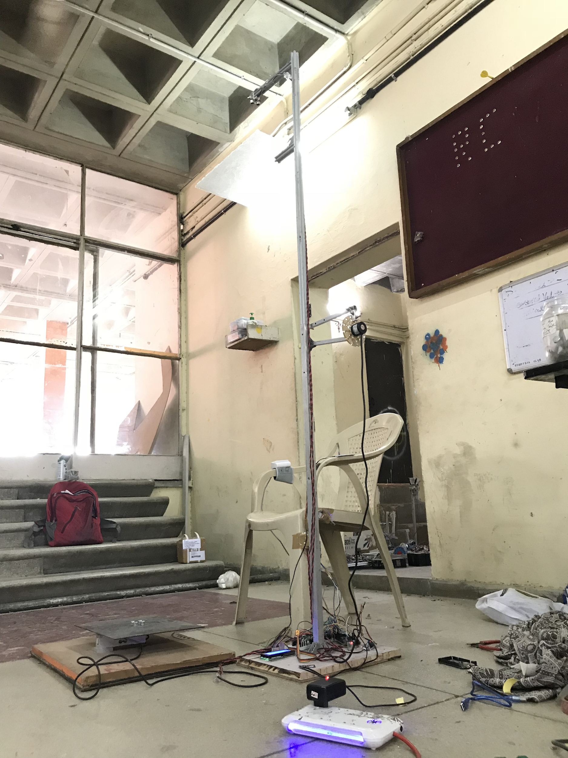
Milestones Achieved and Systems that are Functional
Height Measurement
Weight Measurement
Body Temperature
Lung Capacity
Blood Pressure
Heart Rate
Control through HealthM Android app as well as numpad
Storage of data in online database (Firebase database)
Storage in SD card (use without android app)

Slide 4
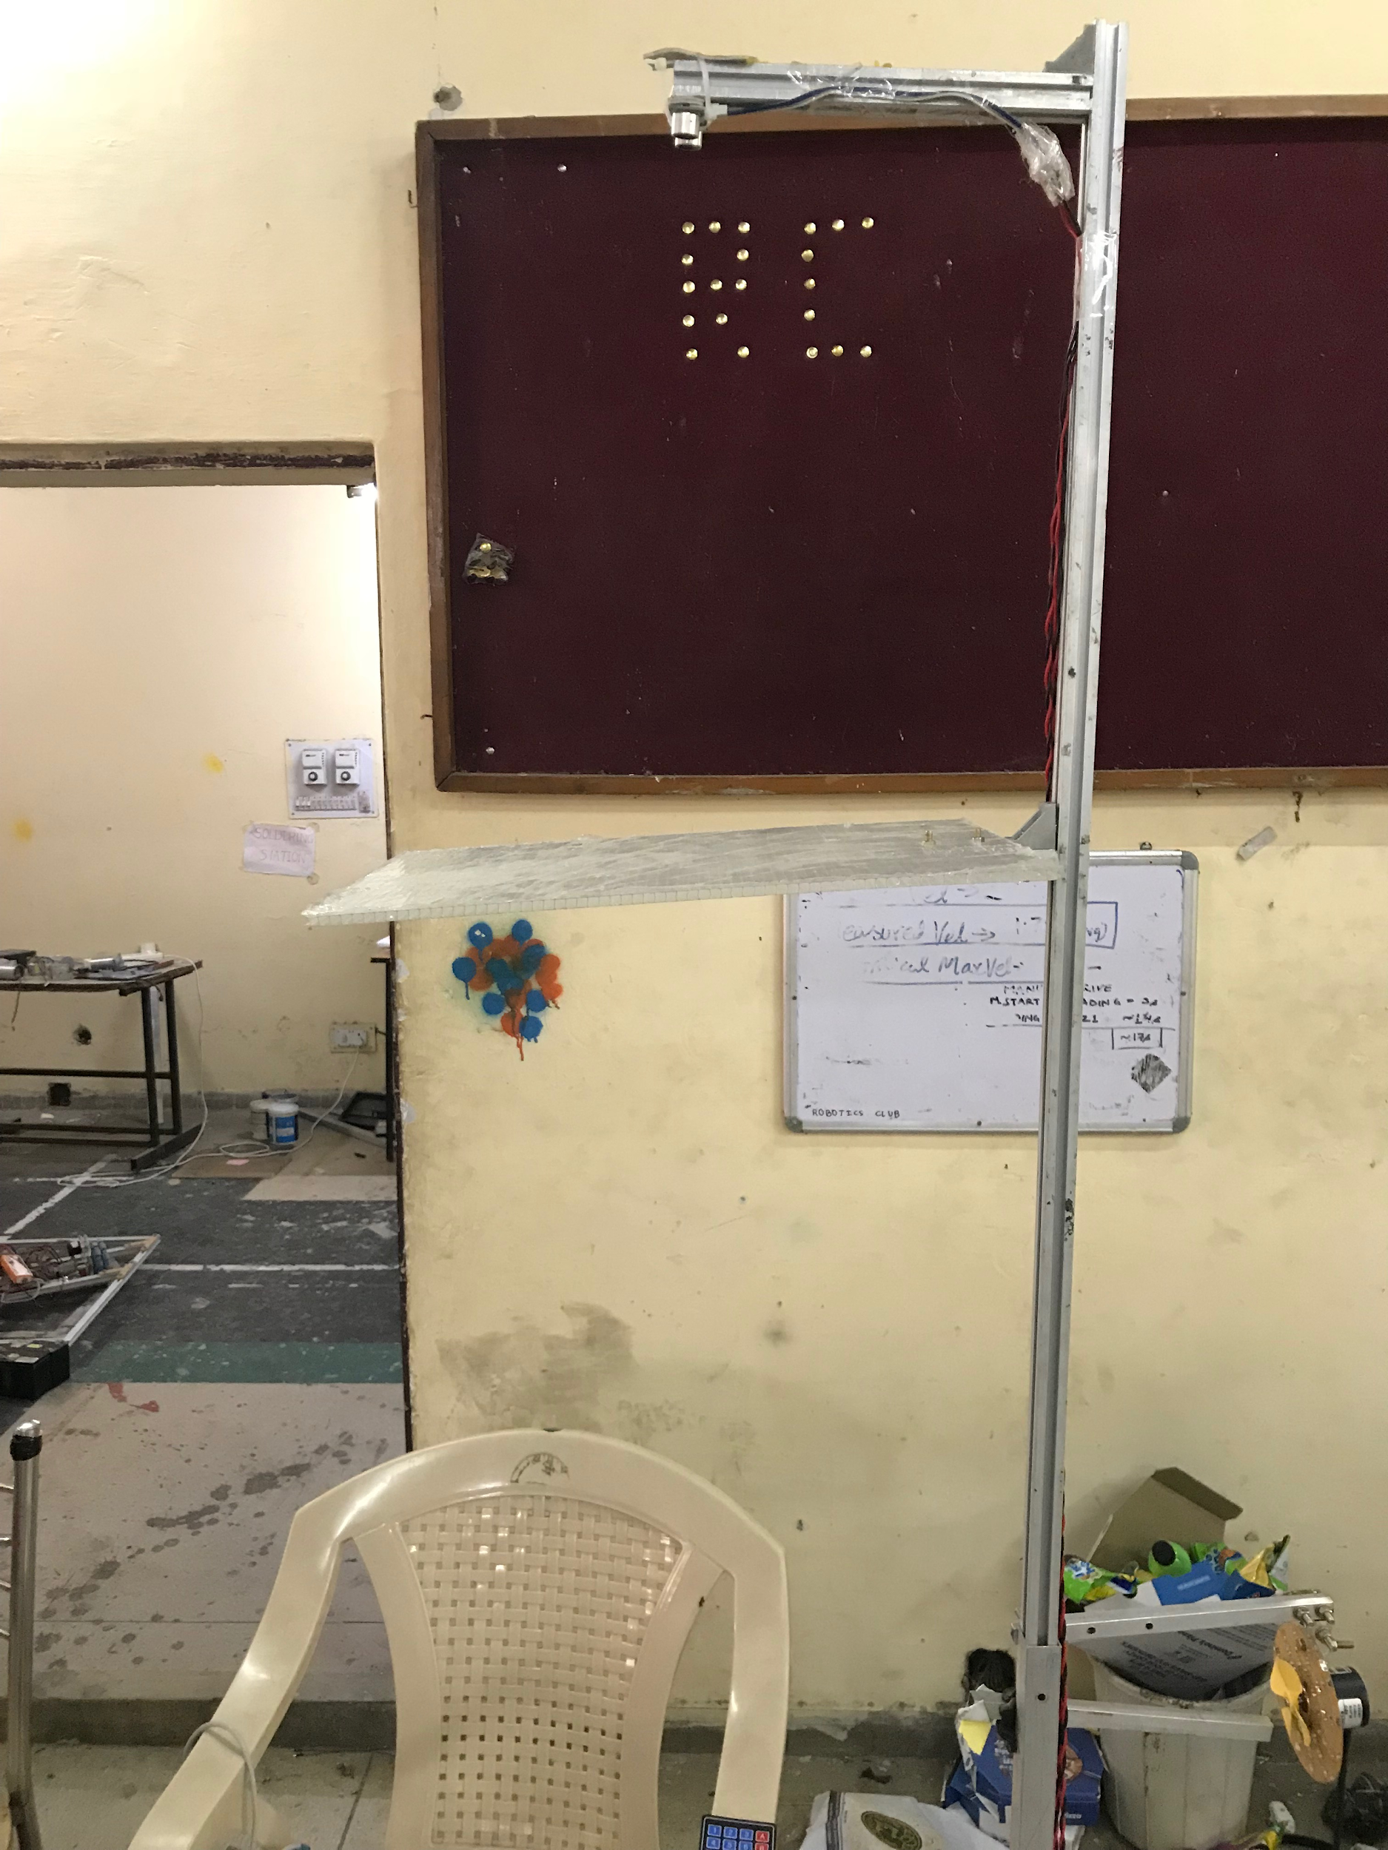
Height Measurement
Designed using hex channels.
Uses Ultrasound sensor HC-SR04.
Can be slided one into the other to make it motile.
Readings are taken accurately by calculating average values.

Slide 5
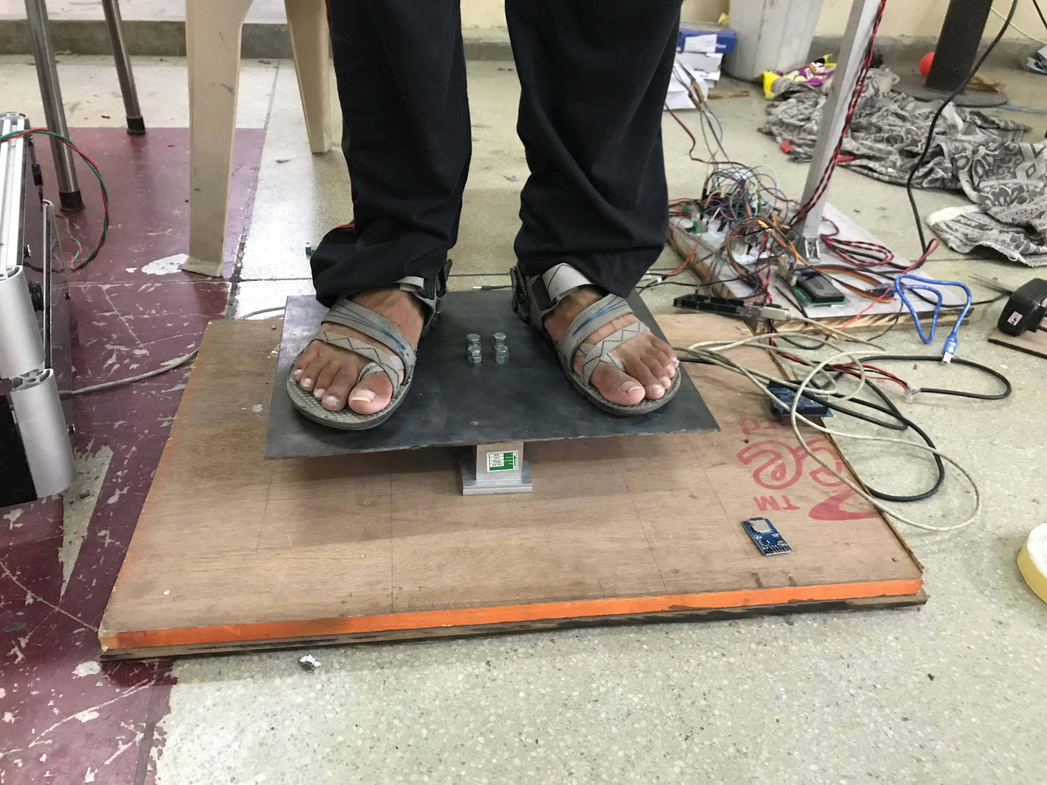
Weight Measurement
Uses load cell CZL642 with amplifier HX711.
Designed using Al blocks, wood and MS sheets.
Shear point force load cell.
Accuracy upto +(-) 0.5 kg.
Average values are taken for accuracy

Slide 6
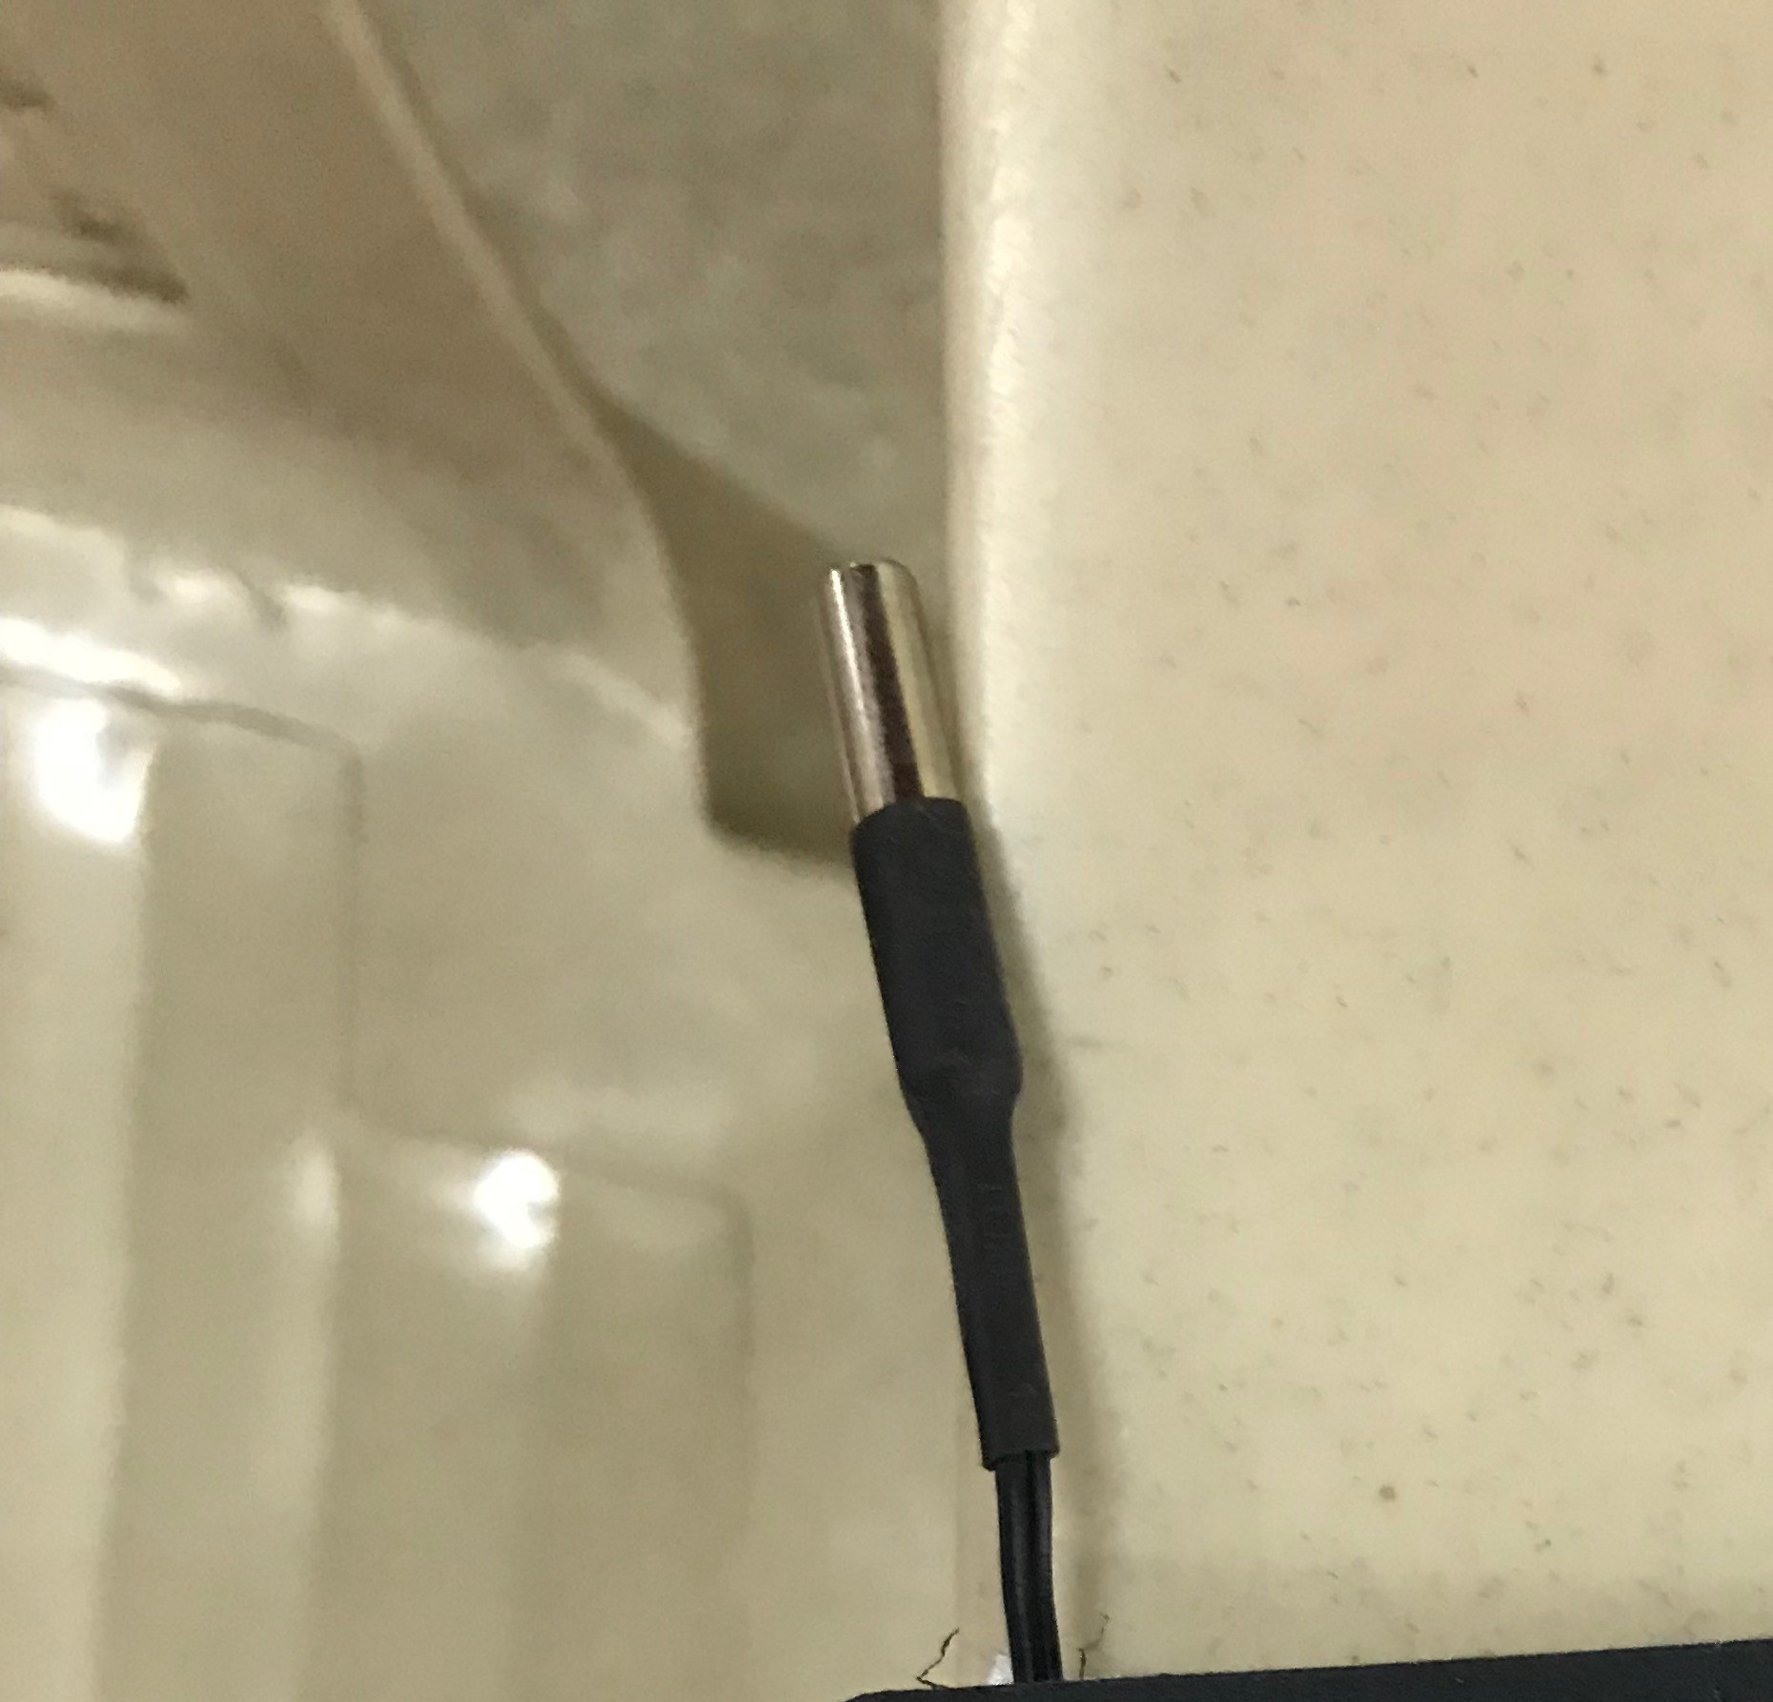
Body Temperature
Use NTC thermistor.
Readings taken after 1.5 minute since some time is taken to reach constant temperature by thermistor.
Gives accurate and consistent reading.

Slide 7
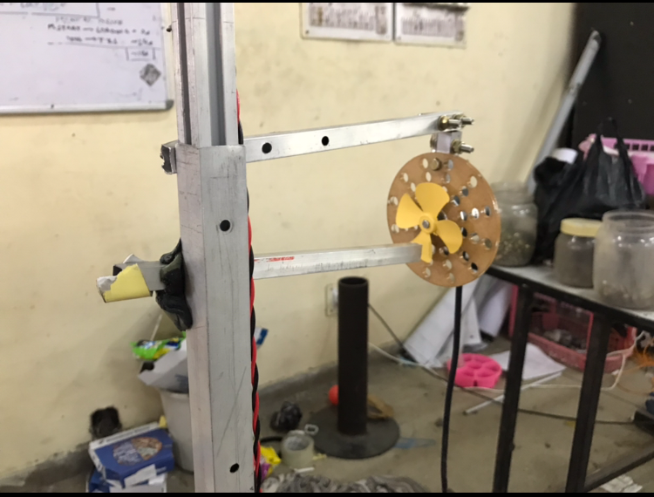
Lung Capacity
Uses rotary encoder.
User required to blow on a small fan.
Measures total number of rotations.
Approximation of air expelled (tidal capacity).
Calculates average and maximum speeds.
Calibration done using rotameter to give exact air volume expelled.

Slide 8
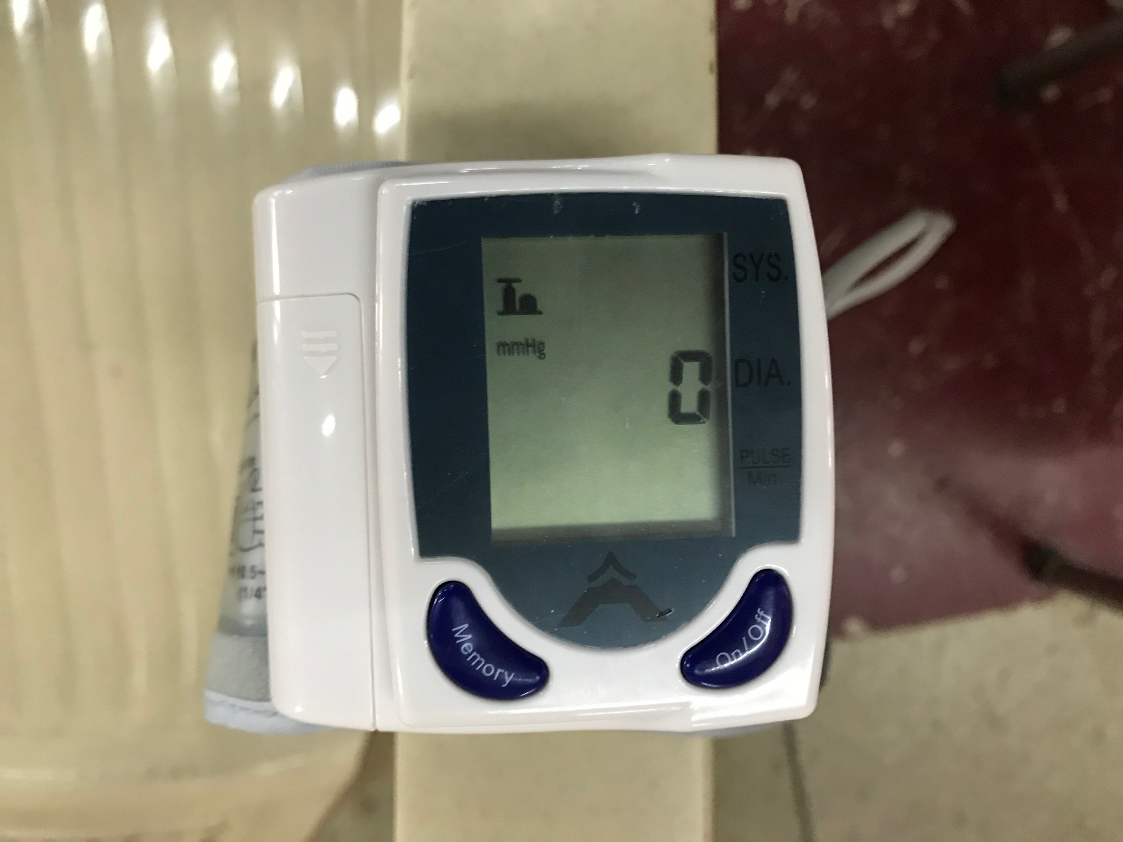
Blood Pressure and Heart Rate
Uses a device developed by SUNROM pvt lim.
The readings are taken through Serial Output into the Arduino and then transmitted to the Android App.
Values are stored in online Database and heart rate is also stored separately by the same device.

Slide 9
HealthM - Android App
A special app with the purpose of controlling the monitoring system easily by a layman and storing data online to make it available to the user anytime and anywhere is created as an extension of the project
It stores all the user info with unique id and gives the report if needed.
Soon some basic tips will be feeded in the app to give health advice to the user.
Even features like online chatting with a doctor can be integrated with the app for facilitating the patient.

Slide 10
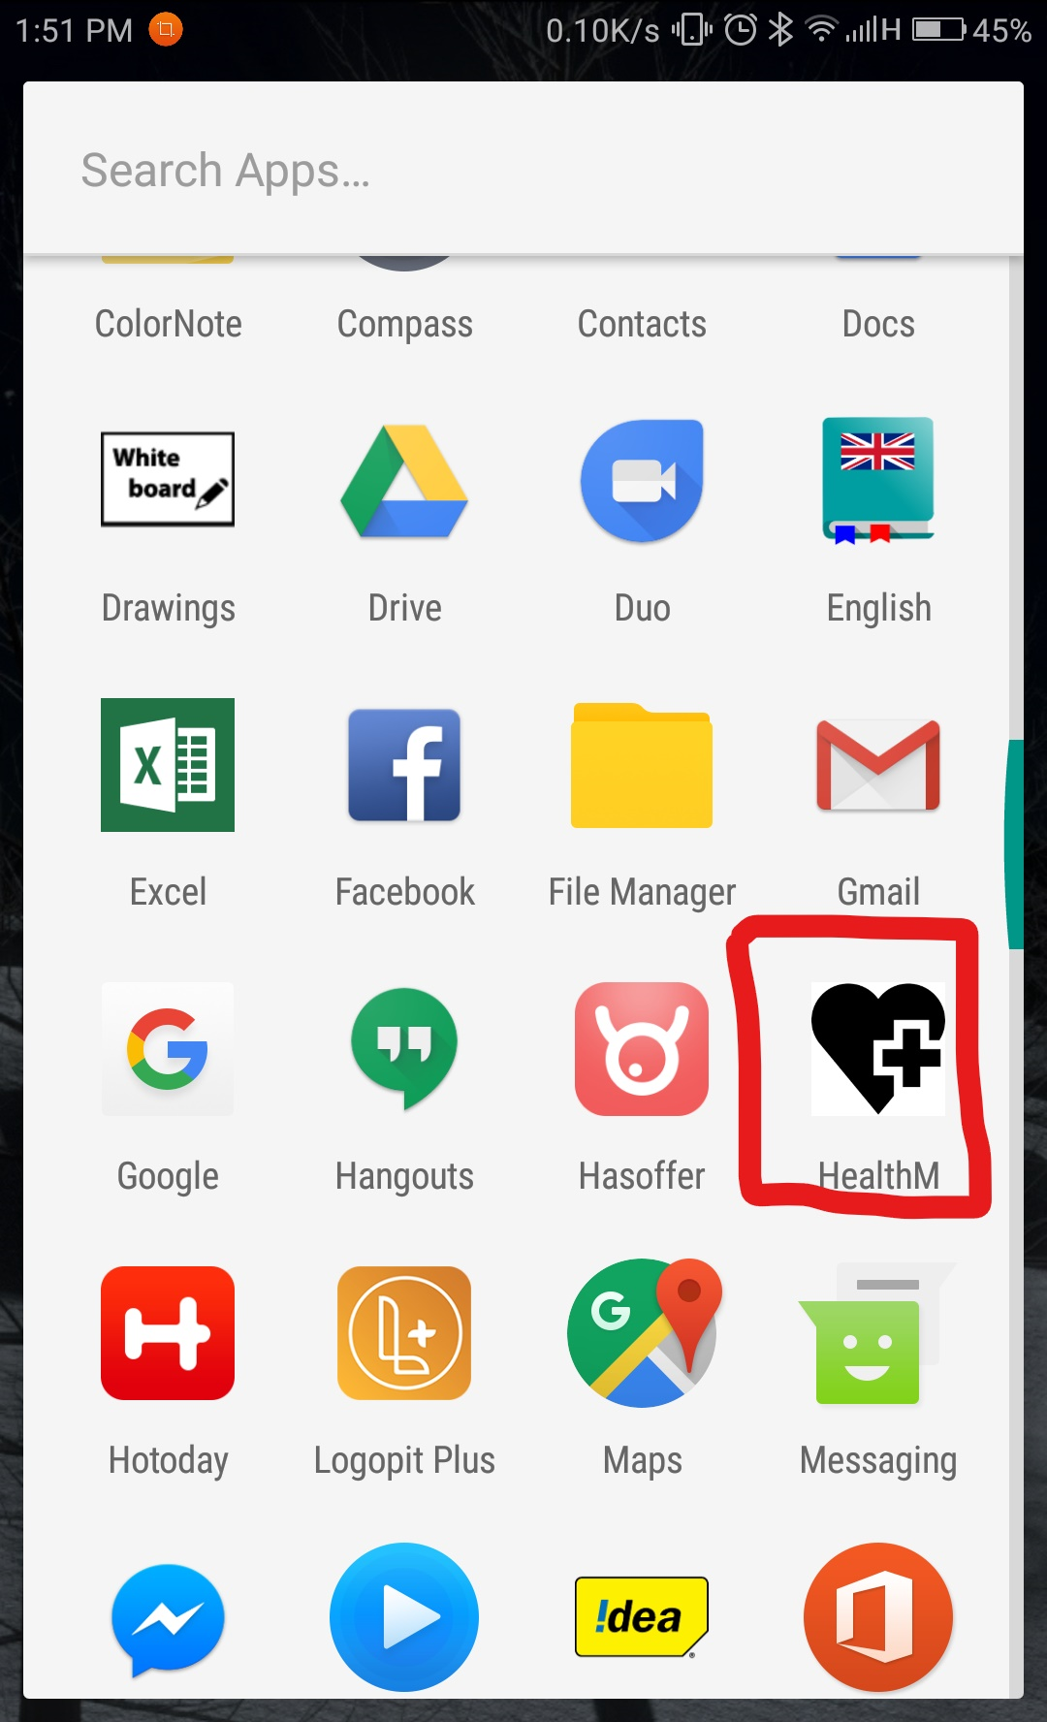
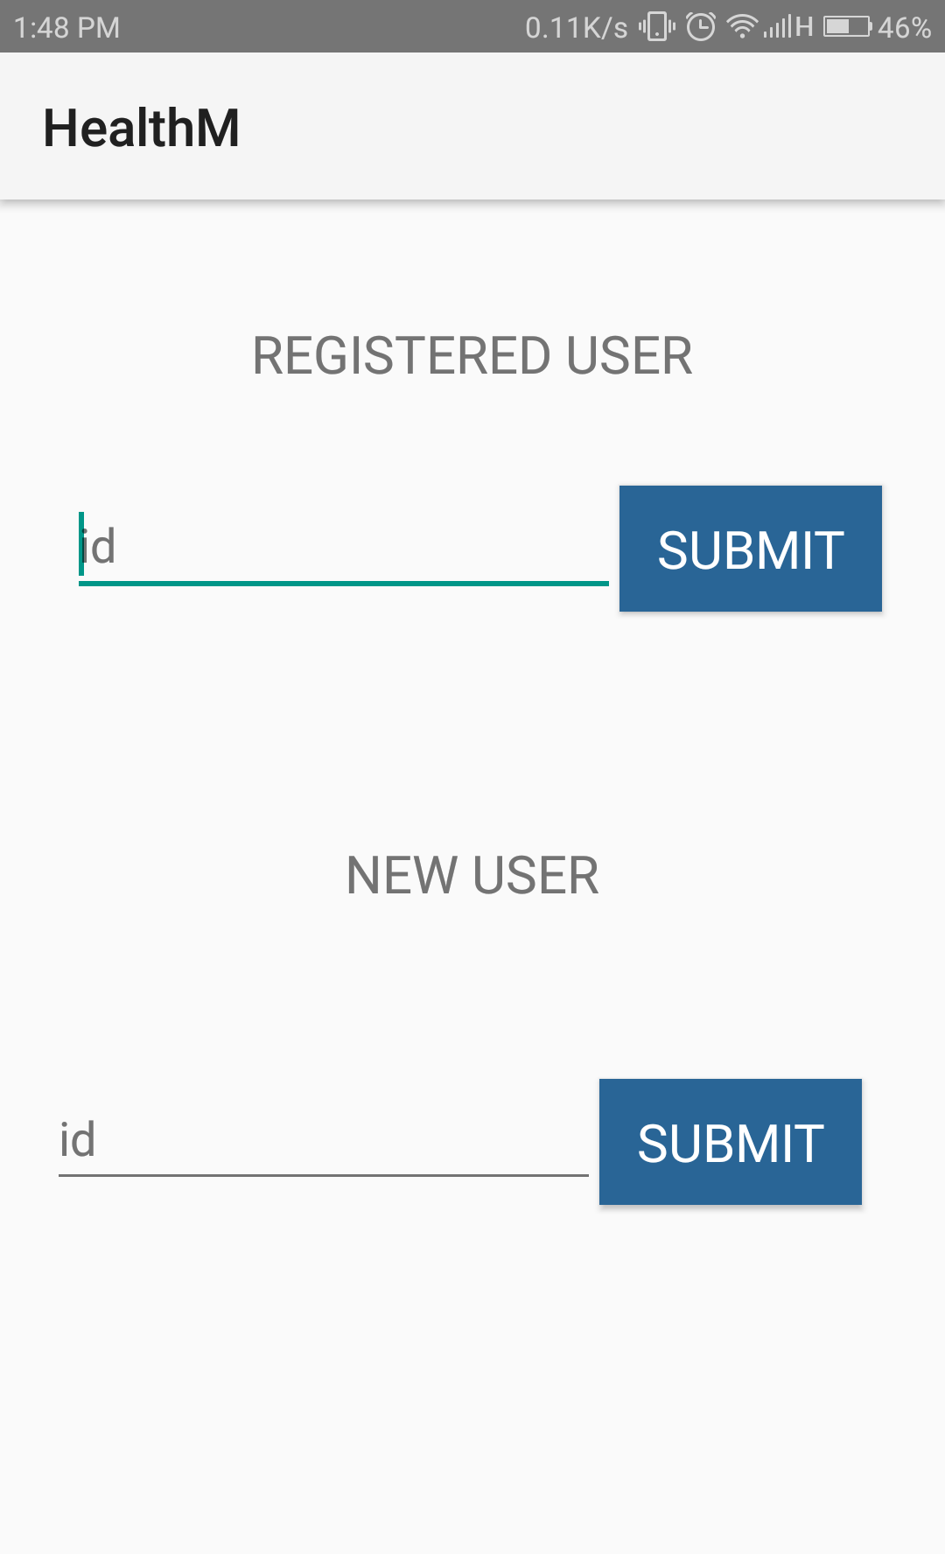
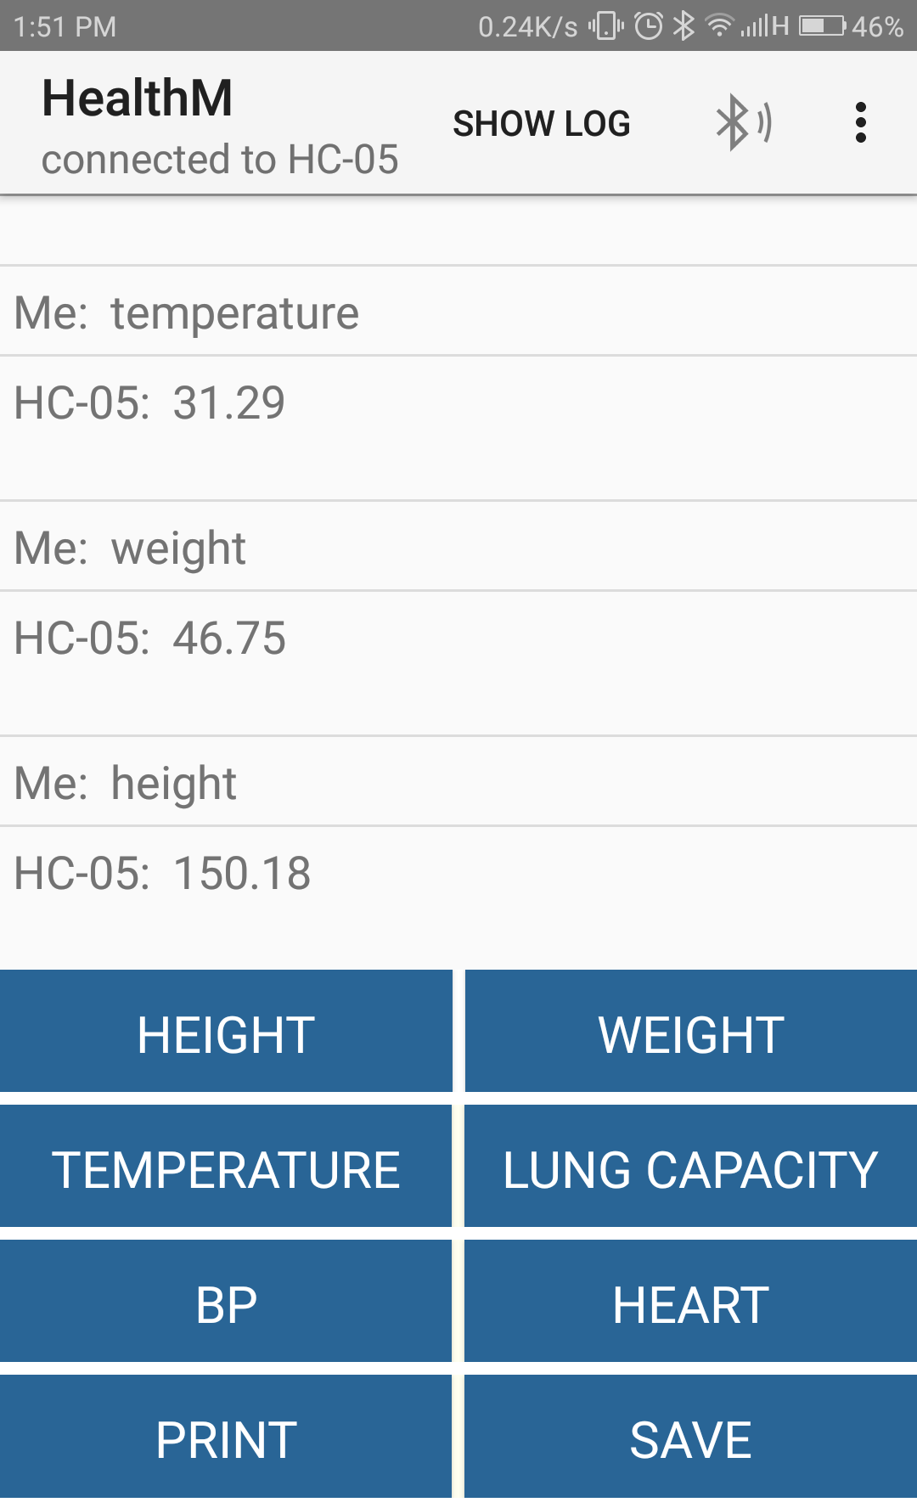
HealthM - Android App

Slide 11
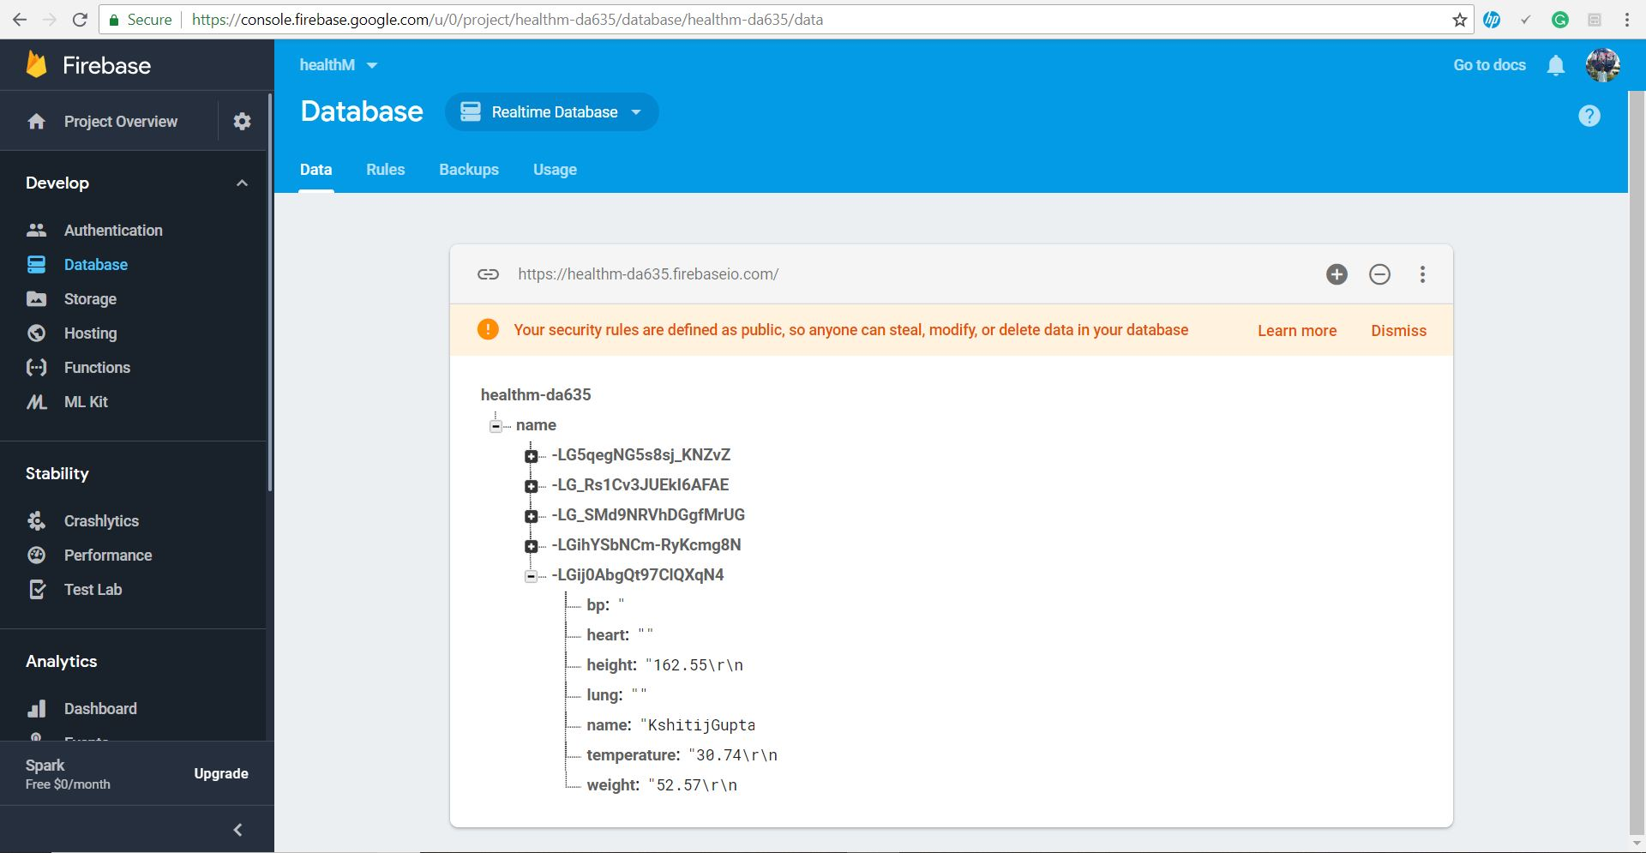
Firebase Database

Slide 12
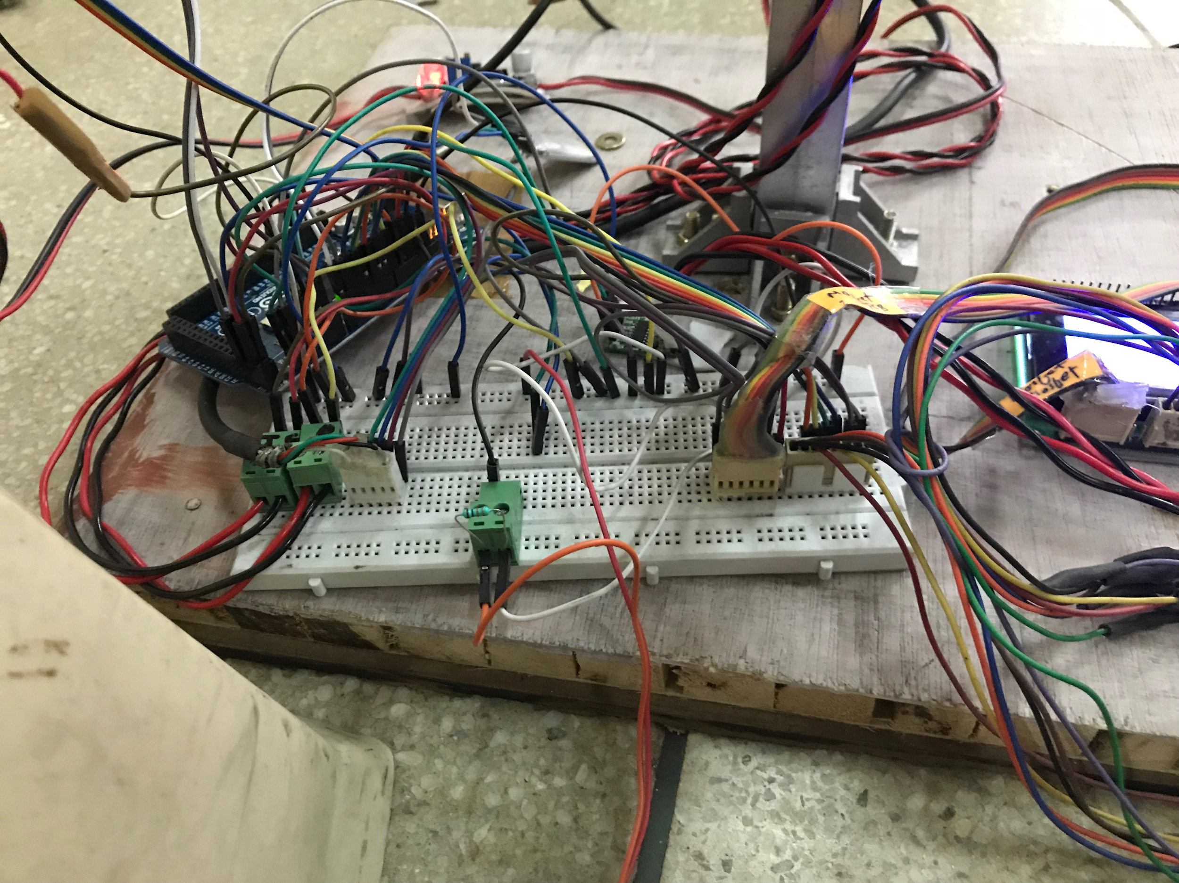
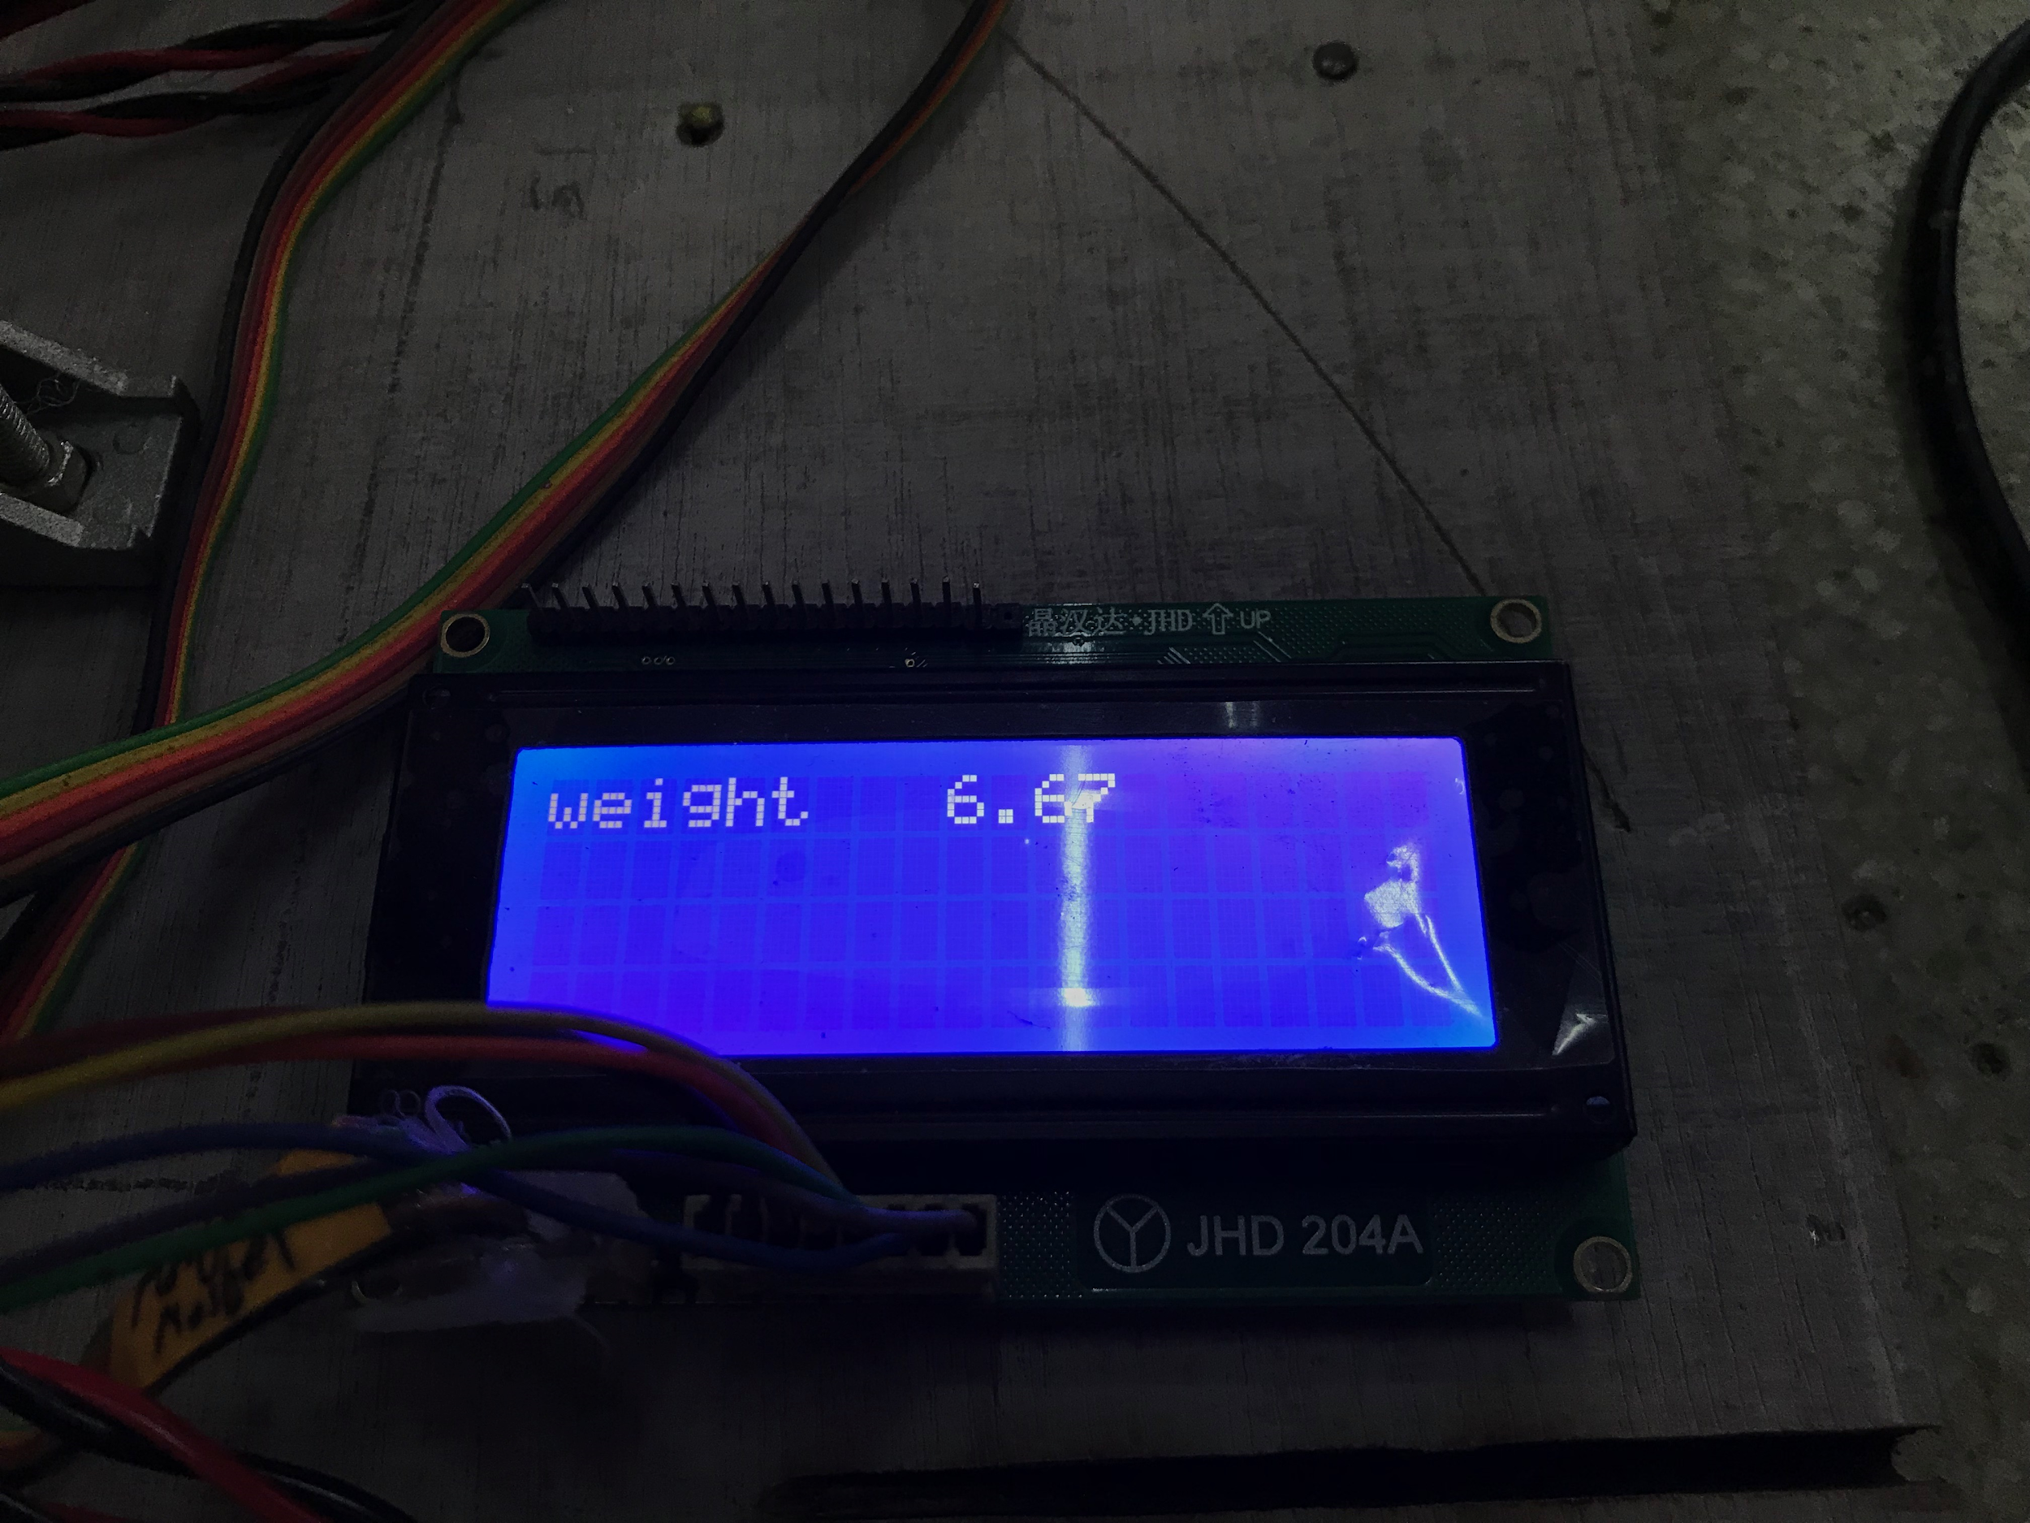
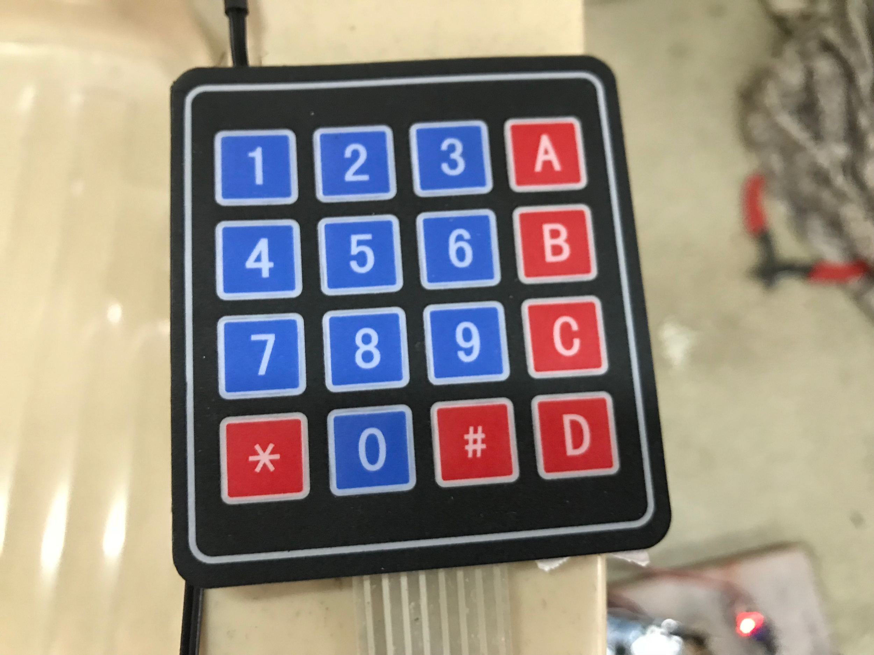
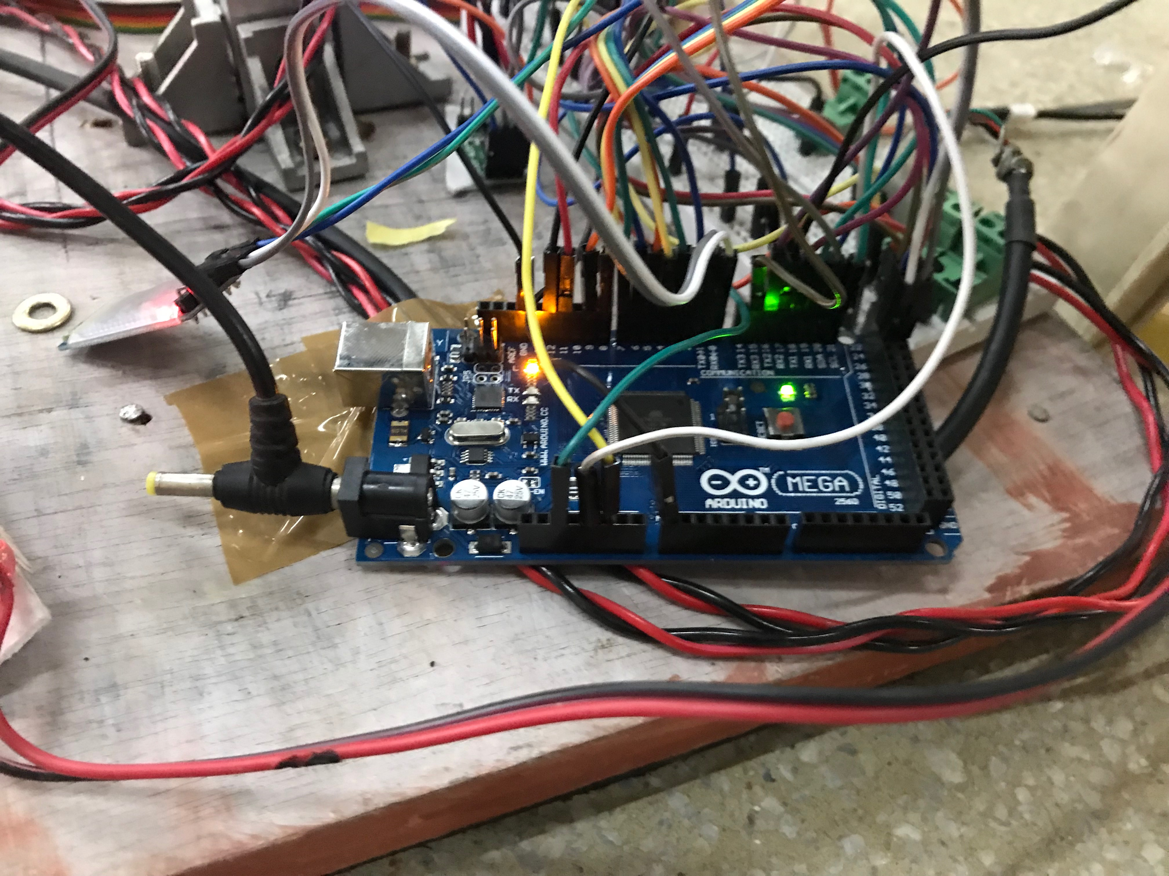
Circuitry
Complete Circuit →
16X2 LCD output.
SD card storage of data for future comparison.
Bluetooth module HC-05
Voltage Converter HW411
Arduino Mega 2560
Sensors -
Ultrasound HC-SR04
Load Cell CZL642
NTC Thermistor
Rotary Encoder
BP and Heart Rate machine

Slide 13
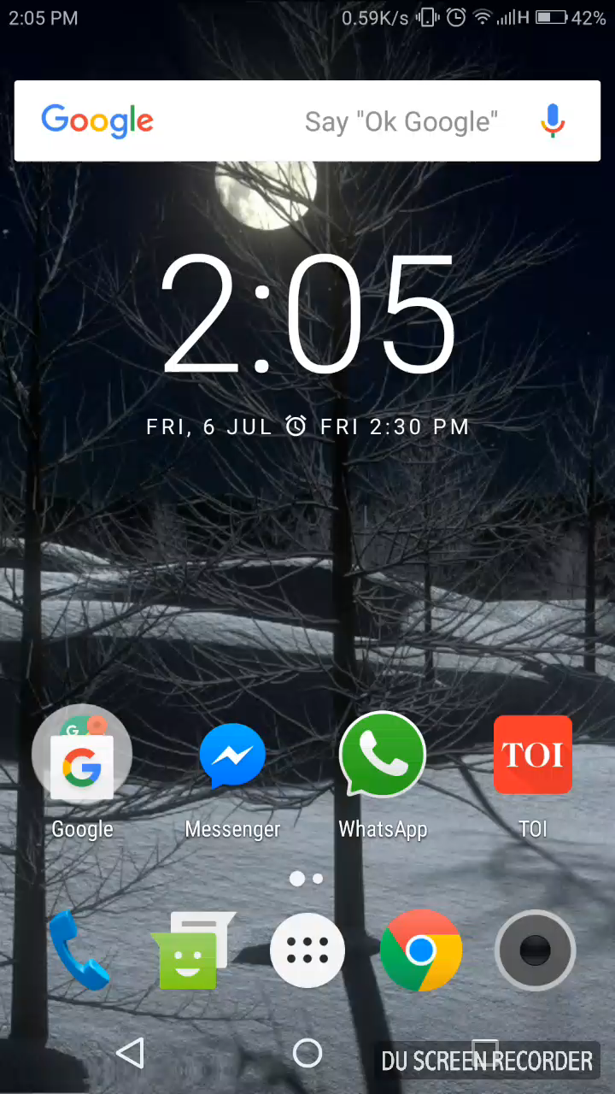
Working Video

Slide 14
Challenges
We faced major issues while designing the weighing machine. First, the output we were getting was very inconsistent and we bought a new amplifier to no improvement, only to realize later on, that the load to be applied was to be a point load as it worked on principle of shear forces.
We had to buy three devices for temperature measurement. The first, LM-35 was taking time in giving stable reading which were as it is, far from accurate. The second second sensor DS18B20 was faulty.
Getting a blood sugar level output for microcontroller.

Slide 15
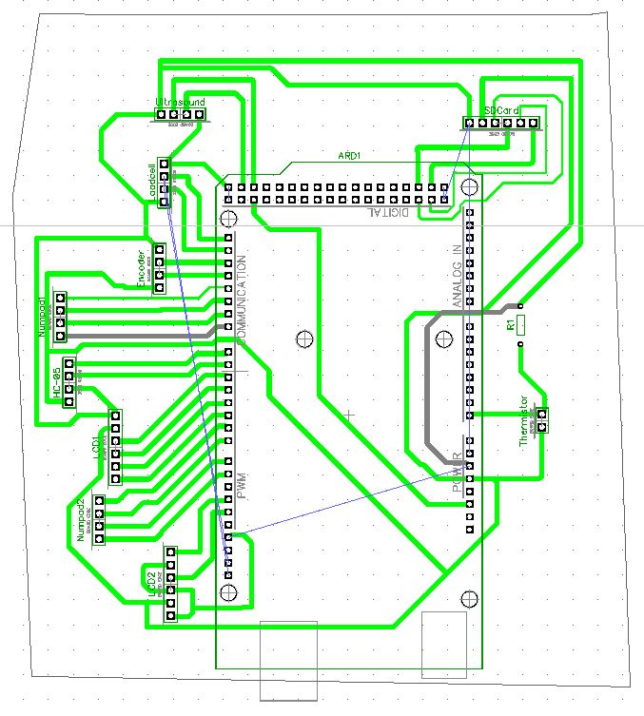
Work remaining
Blood sugar level testing
Printing PCB for our circuit.
Designed completely for the circuit designed so far;, only the Sugar level machine part is remaining
Data for health tips to be added in the app database
Arduino Mega 2560
Proposed PCB Design

Slide 16
Concept prototype
Make video parallel
Future possibilities
Develop functional prototype with financial support from IIT
Make hospital visits
Future plans and budget
CAD model of finished product with bone structure

